Slide 1
PID CONTROLLER
P=Proportional
I=Integral
D=Derivative

Slide 2
PID Controller:
A PID controller is a feedback control system used to regulate continuous processes like temperature, pressure, or flow by adjusting a control output based on the error (the difference between the desired setpoint and the actual process variable).

Slide 3
PID Controller:
It operates based on a mathematical algorithm that continuously calculates and adjusts the control output in response to the error signal. It uses proportional, integral, and derivative terms to determine the control action.

Slide 4
PID Controller:
Typically used for continuous control processes where precise control of a single variable is required, such as maintaining a specific temperature or pressure.
Primarily focuses on feedback control, adjusting a process variable based on measured feedback.

Slide 5
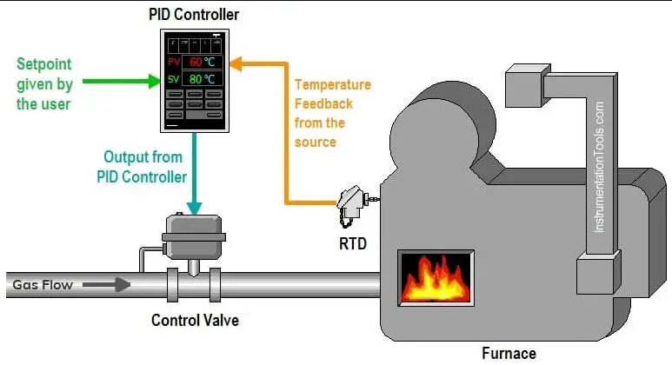
EXAMPLE

Slide 6
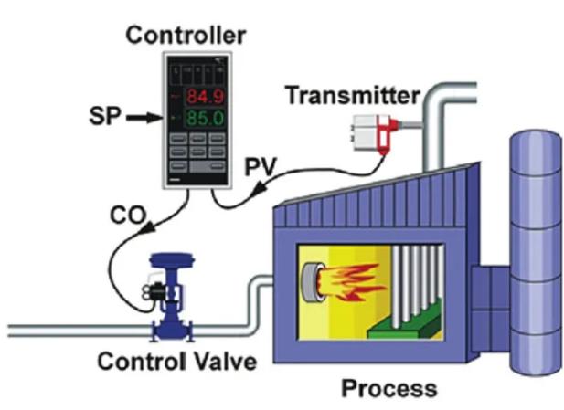

Slide 7
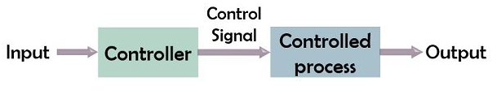
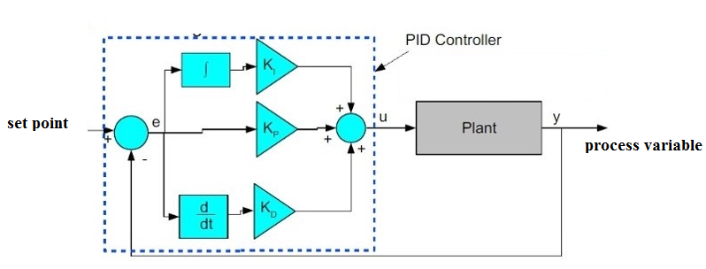
BLOCK DIAGRAM
OPEN LOOP CONTROL SYSTEM
CLOSED LOOP CONTROL SYSTEM

Slide 8
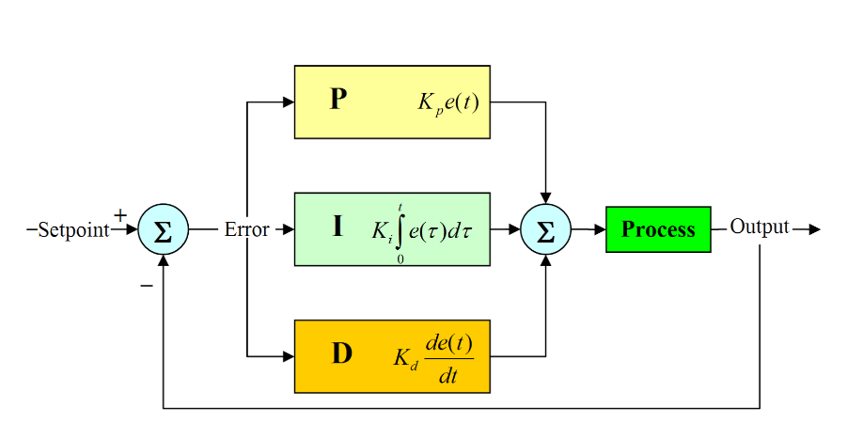

Slide 9
Proportional (P) Control:
The proportional term calculates the difference between the desired temperature (setpoint) and the current temperature (process variable).
Imagine you have an industrial furnace that needs to maintain a constant temperature of 200 degrees Celsius.

Slide 10
Proportional (P) Control:
If the current temperature is 10 degrees below the setpoint (i.e., 190 degrees Celsius), the proportional controller would output a control signal to increase the heat output proportionally to the error.
If the current temperature is 10 degrees above the setpoint (i.e., 210 degrees Celsius), it would output a control signal to decrease the heat output.

Slide 11
Integral (I) Control:
The integral term accumulates the past errors over time.
If there is a persistent error (e.g., the furnace consistently falls short of the setpoint), the integral controller gradually increases or decreases the control signal to eliminate the error over time.

Slide 12
Derivative (D) Control:
The derivative term considers the rate of change of the error.
If the temperature is rising too quickly and approaching the setpoint rapidly, the derivative controller can reduce the control signal to prevent overshooting.

Slide 13
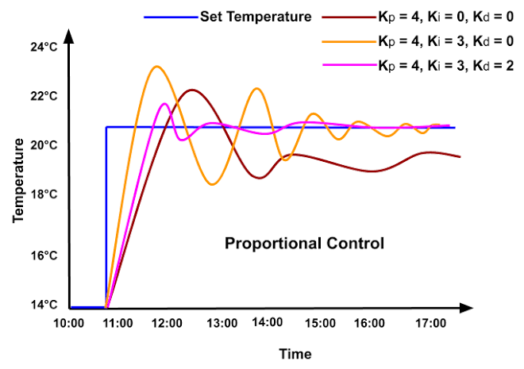
GRAPH

Slide 14
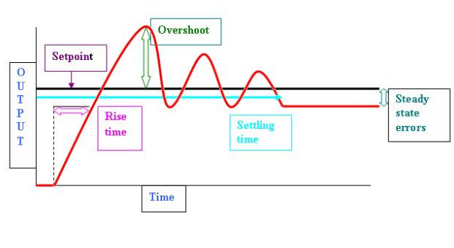
ERRORS

Slide 16
APPLICATIONS
This type of control is commonly used in various industrial processes, such as chemical manufacturing, HVAC systems, and food production, where maintaining a specific setpoint is critical for product quality and process efficiency.

Slide 17
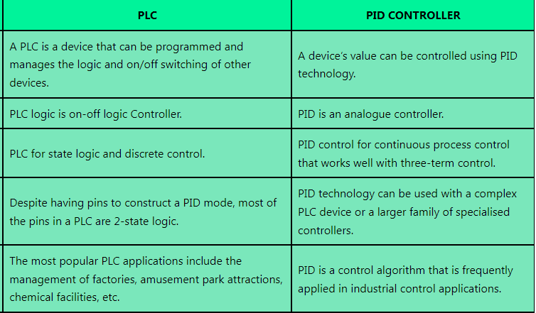
Difference between PLC and PID controller

Slide 18
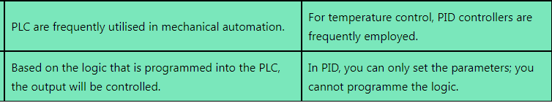
Difference between PLC and PID controller

